Slide 1

Write An Objective Function (1)
Professor Bo Liu
James Watt School of Engineering

Slide 2
Objective functions
It is often necessary to write a function for evaluation purpose
  Cost functions (used everywhere): evaluate the cost of a given problem solution.
  Loss functions (used in machine learning): evaluate how wrong an answer is.
  Fitness functions (used by genetic algorithms): opposite to loss functions.
These types of functions have the same purpose: they evaluate the performance of a provided input.
In this session we will write the following functions in MATLAB:
  Mean squared error.
  Rastrigin benchmark function.
  Binary cross entropy function (next session).

Slide 3
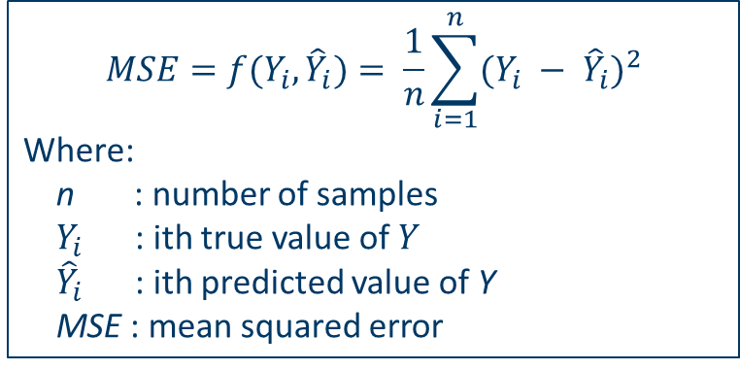

Mean Squared Error
The mean squared error is frequently used as a loss function in machine learning. Formula:
$$MSE=f(Y_{i},{\hat{Y}}_{i})= \frac{1}{n}\sum_{i=1}^{n}{{(Y_{i} − {\hat{Y}}_{i})}^{2}}$$
Where:
n : number of samples
$Y_{i}$ : ith true value of $Y$
${\hat{Y}}_{i}$ : ith predicted value of Y
MSE : mean squared error
Example:
  The true values for a variable Y at two instances are 0.8 and 0.9, while at those instances, predictions of 0.75 and 0.85 are made.
  Then: $MSE= \frac{1}{2}∗{(\left(0.8−0.75\right)}^{2}+{\left(0.9−0.85\right)}^{2})=2.5×{10}^{−3}$
  If the predictions are 0.8 and 0.9 (true values), then the error is 0.

Slide 4

Mean Squared Error as MATLAB code
The mean squared error function can be written in MATLAB as:
Since this is a simple one-line function, it could also be written as a MATLAB anonymous function:
For the test case, this function provides the following answer:
function MSE = meanSquaredError(preds, trues)
MSE = mean((preds-trues).^2);
end
meanSquaredError = @(preds, labels) mean((preds-labels).^2);
x = [0.75, 0.85];
y = [0.8, 0.9];
meanSquaredError(x, y)
See live script

Slide 5
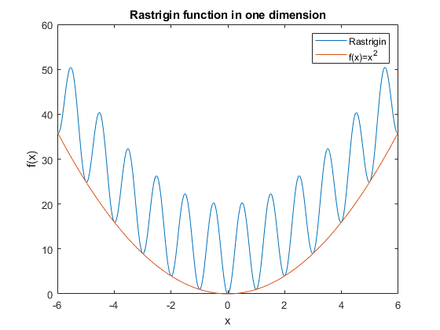
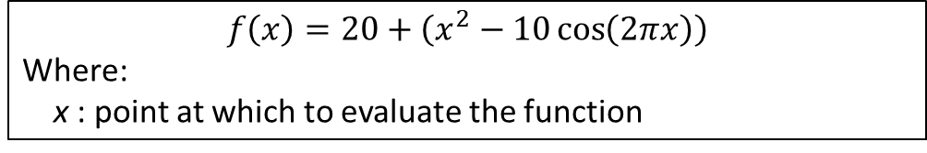
Rastrigin 1 dimension
1D formula:
$$f\left(x\right)=20+\left(x^{2}−10\cos\left(2πx\right)\right)$$
Where:
x : point at which to evaluate the function

Slide 6
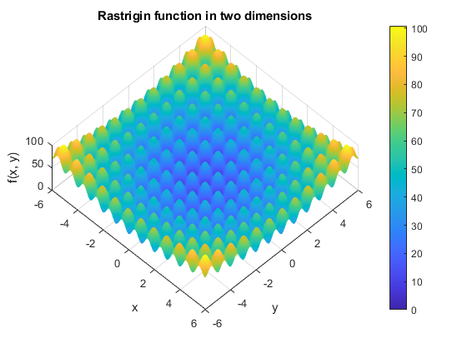
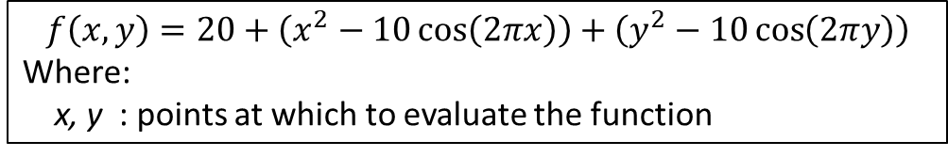
Rastrigin 2 dimensional
2D formula:
$$f\left(x, y\right)=20+\left(x^{2}−10\cos\left(2πx\right)\right)+\left(y^{2}−10\cos\left(2πy\right)\right)$$
Where:
x, y : points at which to evaluate the function

Slide 7
MATLAB code
The 2D Rastrigin function as a MATLAB anonymous function:
This function can also be used as the one-dimensional version by passing 0 as the y argument.
The Rastrigin function is often used to test the performance of optimization algorithms.
  A good benchmark test problem due to many local minima.
A vector x, which can be of any dimensionality (e.g., 10D), is used. How should I write the code?
rastrigin = @(x, y) 20 + (x.^2 - 10.*cos(2*pi.*x)) + (y.^2 - 10.*cos(2*pi.*y));
See live script

Slide 8




Thanks!
#UofGWorldChangers
@UofGlasgow

